Slide 1
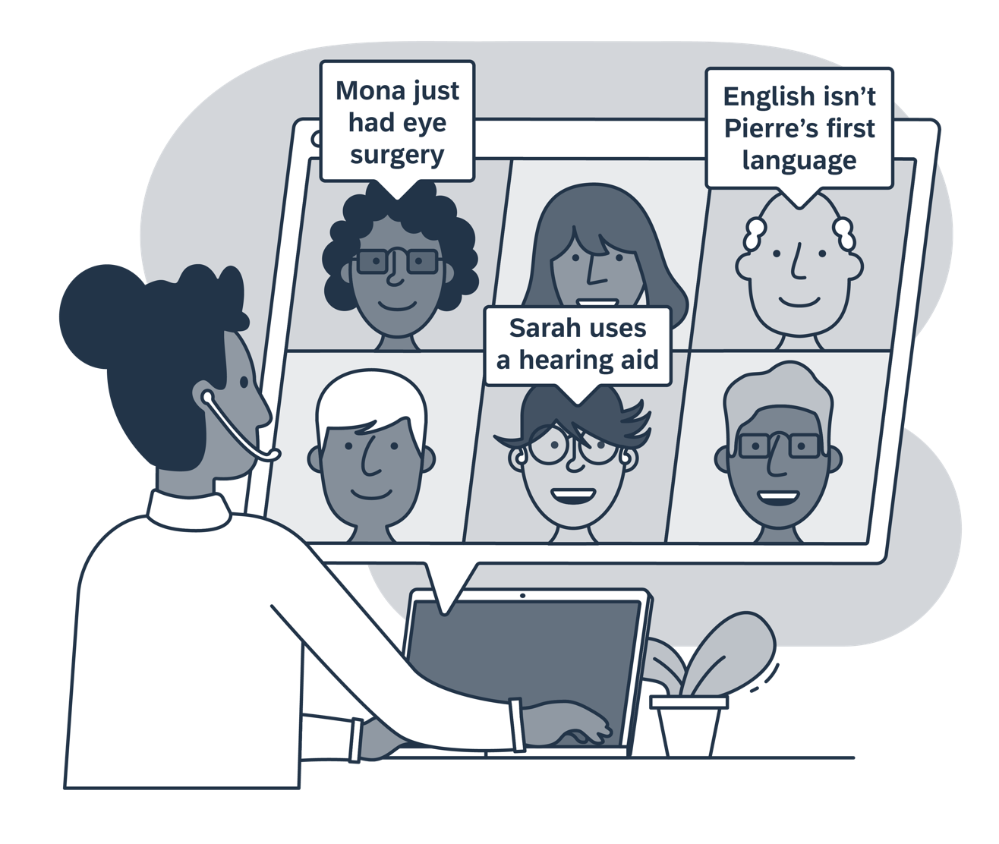
Make it happen for all
Inclusive Meeting Cards
At SAP, we believe everyone should have an equal chance to participate in society and at work.
That’s why we put together this simple set of guidelines with useful hints for preparing for and conducting virtual meetings that work for everyone.
Let’s make our work life more inclusive, one meeting at a time.
Your SAP Design Team

Slide 2
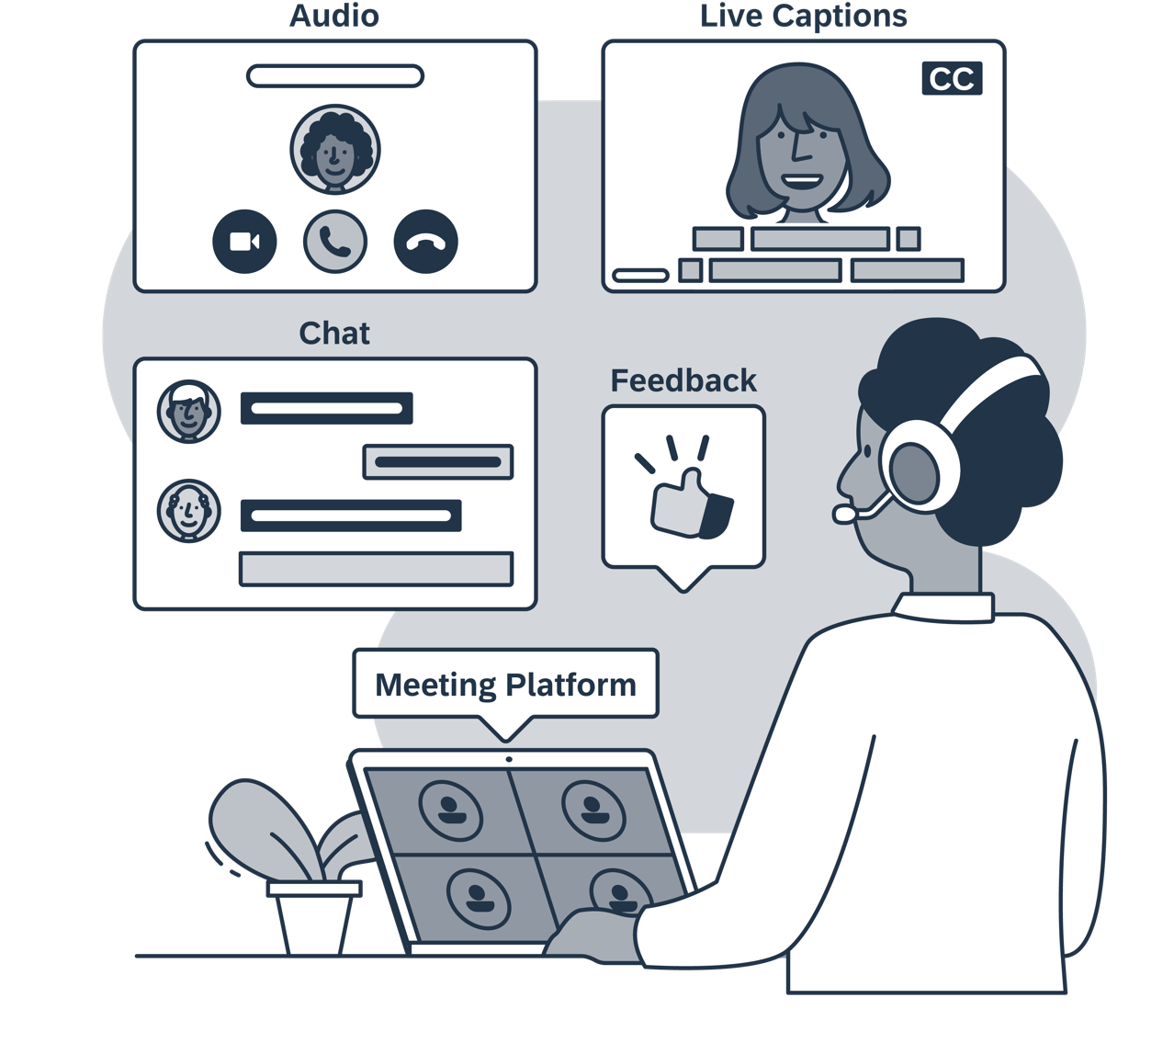
Meeting platform
Choosing accessible technology
Always ensure that the platforms you use are accessible.
Look for settings such as captions, transcripts or subtitles.
Offer participants both audio and chat capabilities.
Ensure that polling tools work for screen reader users as well.

Slide 3
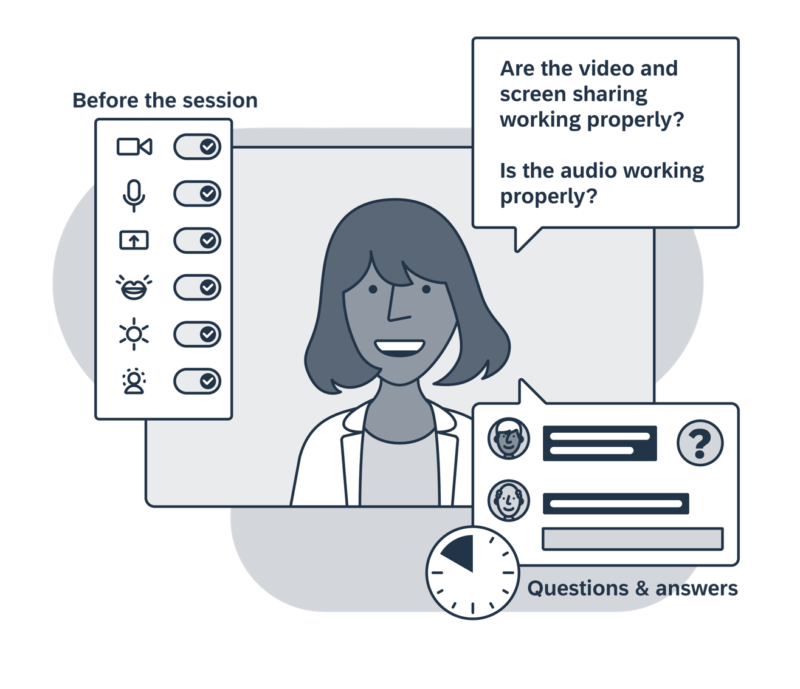
Pre-check
Getting set up
Whatever platform you end up choosing, always check your audio and video are working well in advance.
You might also want to:
Check that your mouth is clearly visible and that you are well lit on the screen.
Use inclusive language. Ask “Is the audio working properly?” rather than “Can everyone hear me?”.
Reduce background noise.
Reserve time for questions and answers via both audio and chat.

Slide 4
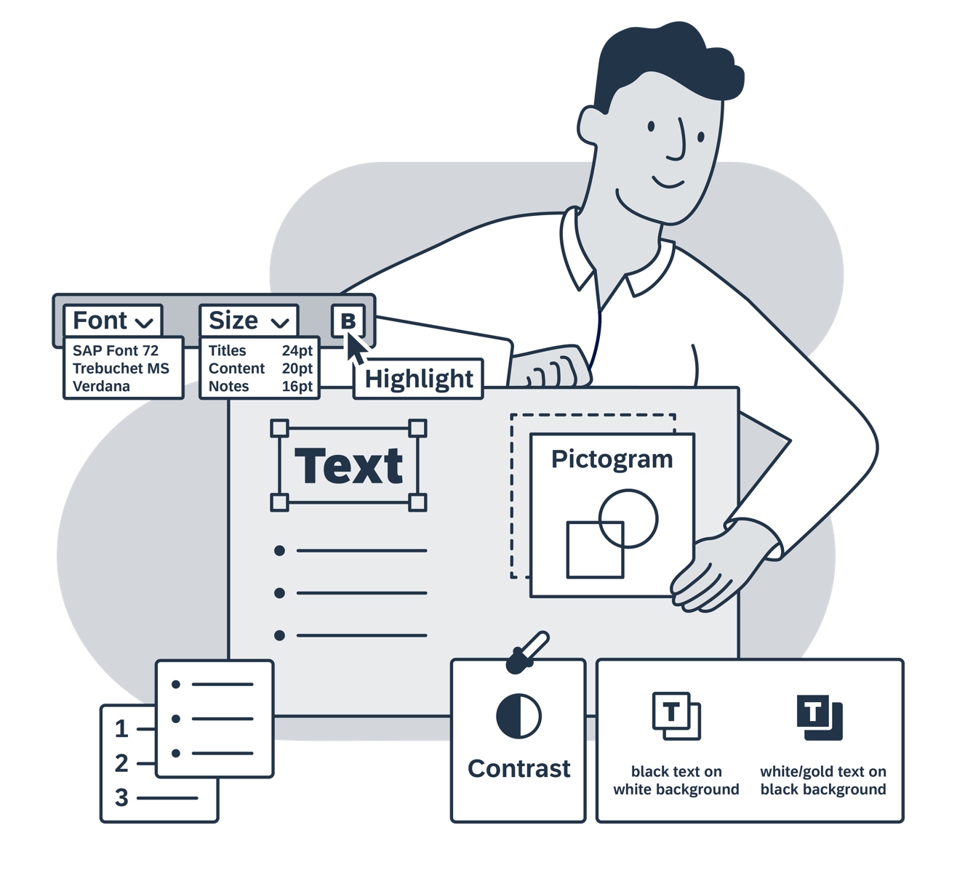
Readability
Structuring your slides
How you structure your slides can help you get your message across more clearly.
Use bullet points or numbers for lists.
Use pictograms instead of photos.
Use accessible, large fonts such as Trebuchet MS or Verdana in 24pt for title and 20pt for content.
Make text stand out using colors and bold, not italics.
Use a strong color contrast for text.

Slide 5
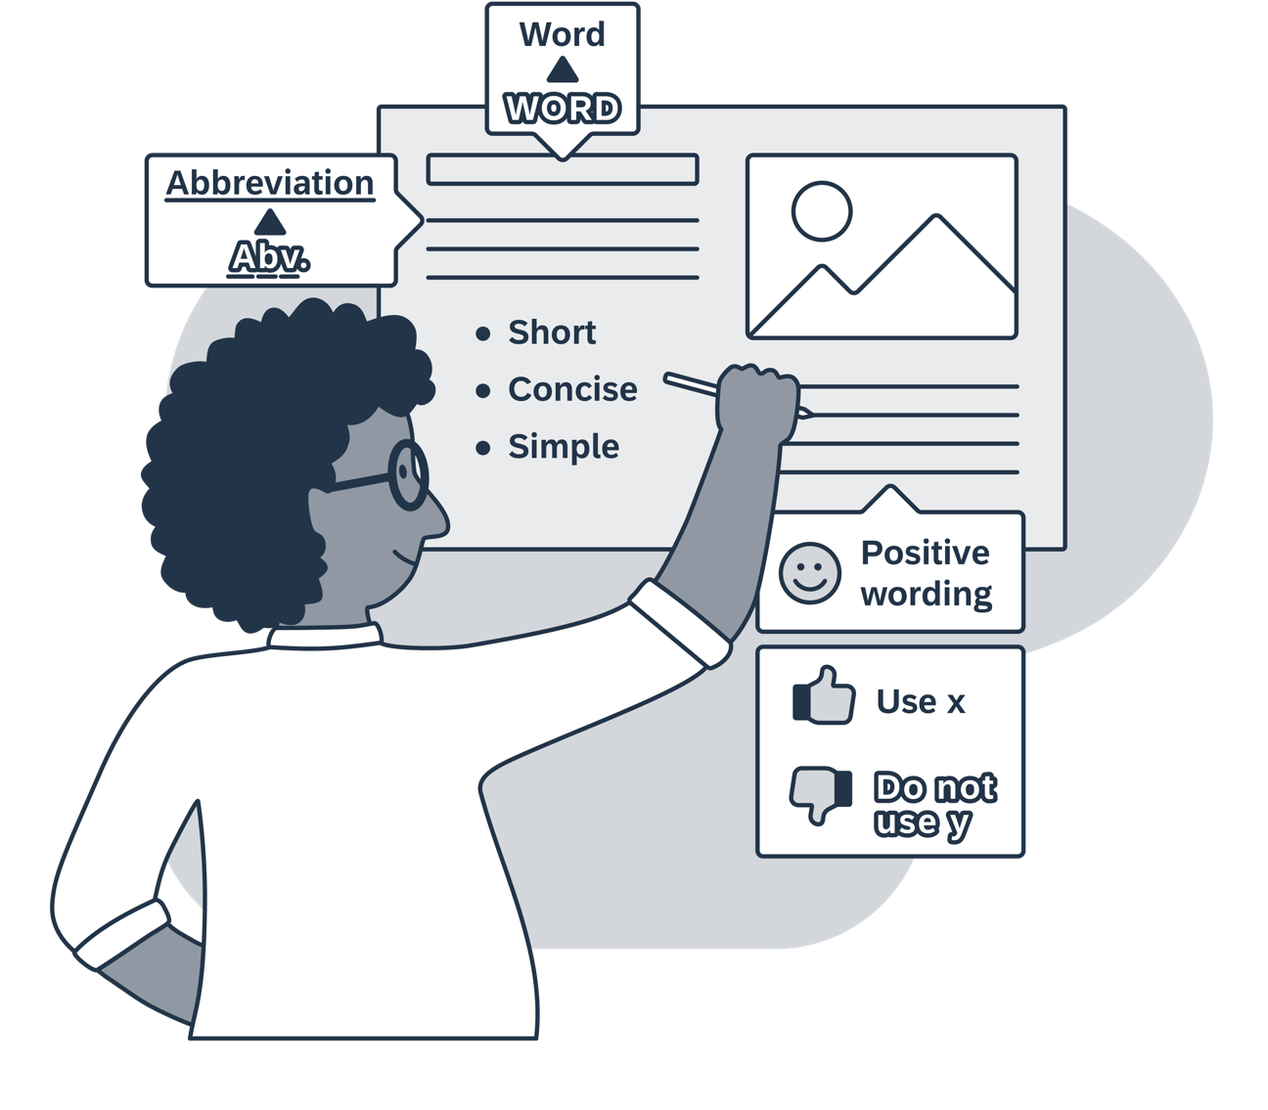
Language
Writing down your message
The words we use and our writing style are critical to ensuring our message is well understood.
Avoid abbreviations and uncommon terms.
Keep sentences short and simple, avoiding metaphors.
Keep it positive! Instead of saying “Do not use x”, try “Use y”.
Use sentence case and avoid capitalizing entire words.

Slide 6
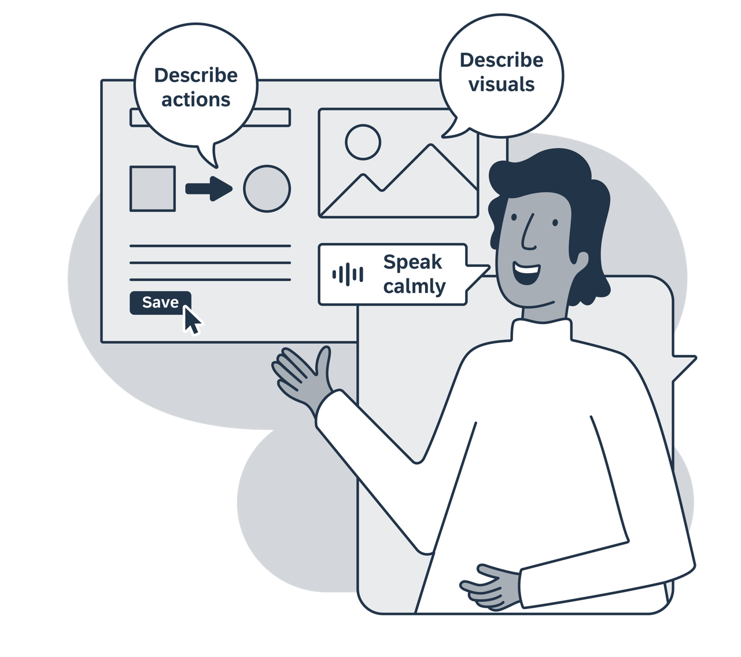
Voice
Speaking during your meeting
When presenting, take a deep breath and…
Speak clearly, calmly, and at a reasonable speed.
Describe important visuals and any relevant actions you are performing, such as clicking buttons or icons.
When responding to questions, first repeat the question for those who were unable to read or hear it.

Slide 7
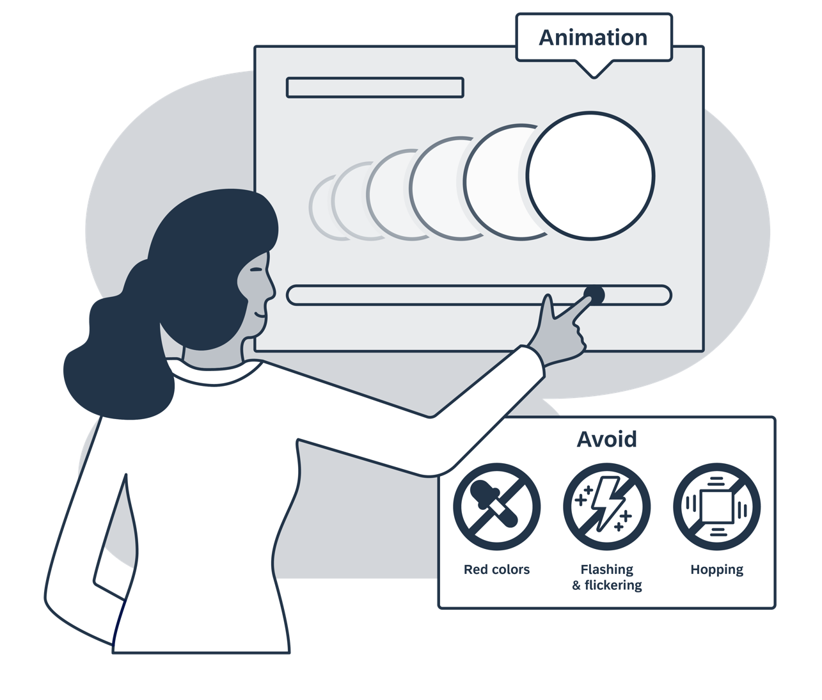
Animations
Calming down visual noise
Animations may distract your audience, and colleagues sensitive to seizures appreciate calm visuals.
Use animations sparsely, reasonably and with care.
Avoid flashing and flickering, which can trigger seizures.
Limit the amount of color red, using it sparsely and with sense.
Avoid hopping (unexpected position changes).

Slide 8
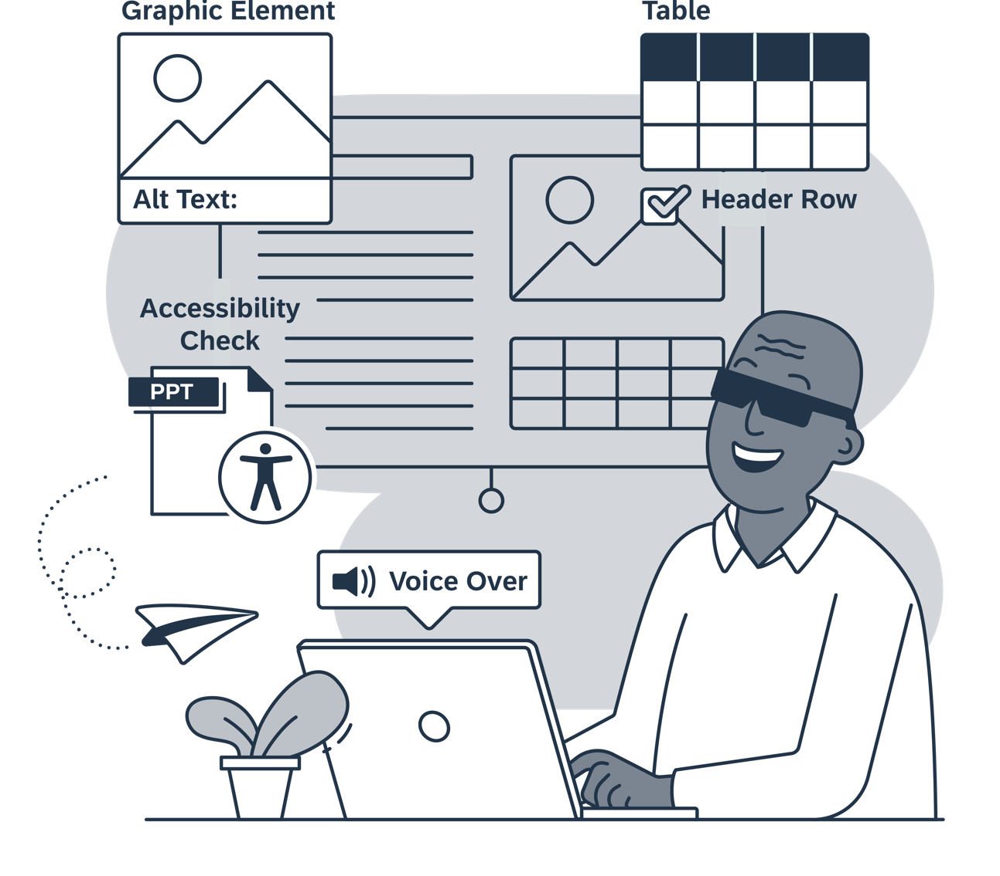
Screen readers
Reading without visuals
If you plan on sharing the presentation material, make sure you provide content that works well with screen readers.
For tables, graphs, and images, describe the content using alternative text.
In tables, always format the first row as a table header.
If using Microsoft PowerPoint®, run an Accessibility Checker report and make sure to address all flagged issues.

Slide 9
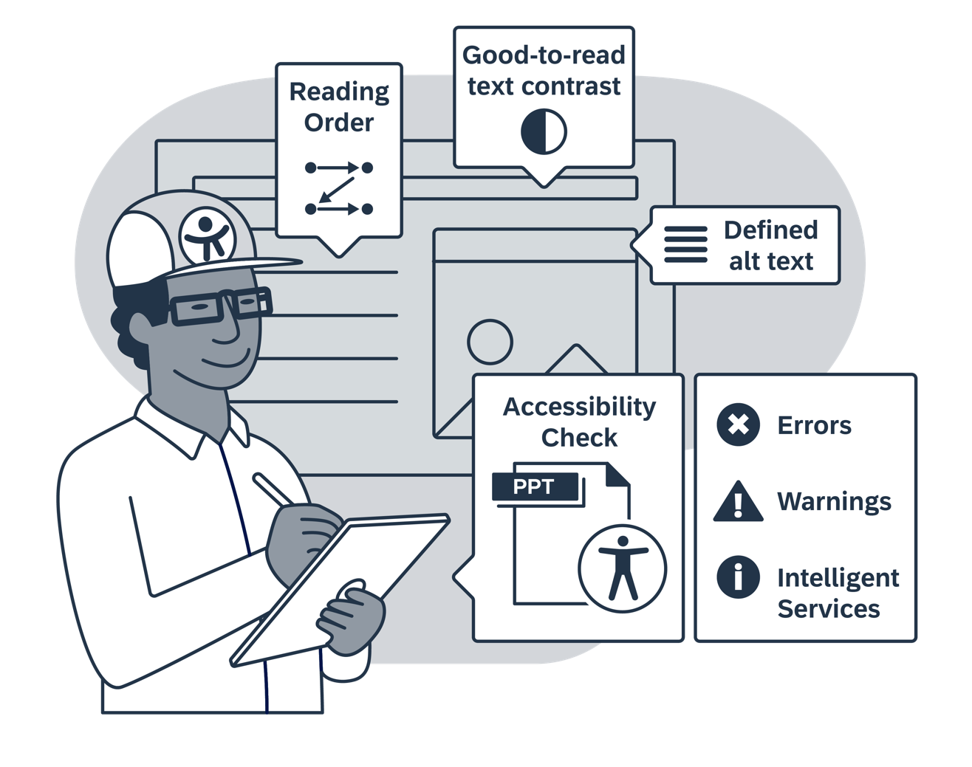
Tools that help
Checking for accessibility
Nowadays many authoring tools provide automatic accessibility checks.
If using Microsoft® products, consider checking your presentations with the “Check Accessibility” feature and adjust or confirm the listed results.
Measure color contrast on in-image text with TPGi’s free Color Contrast Analyser.

Slide 10
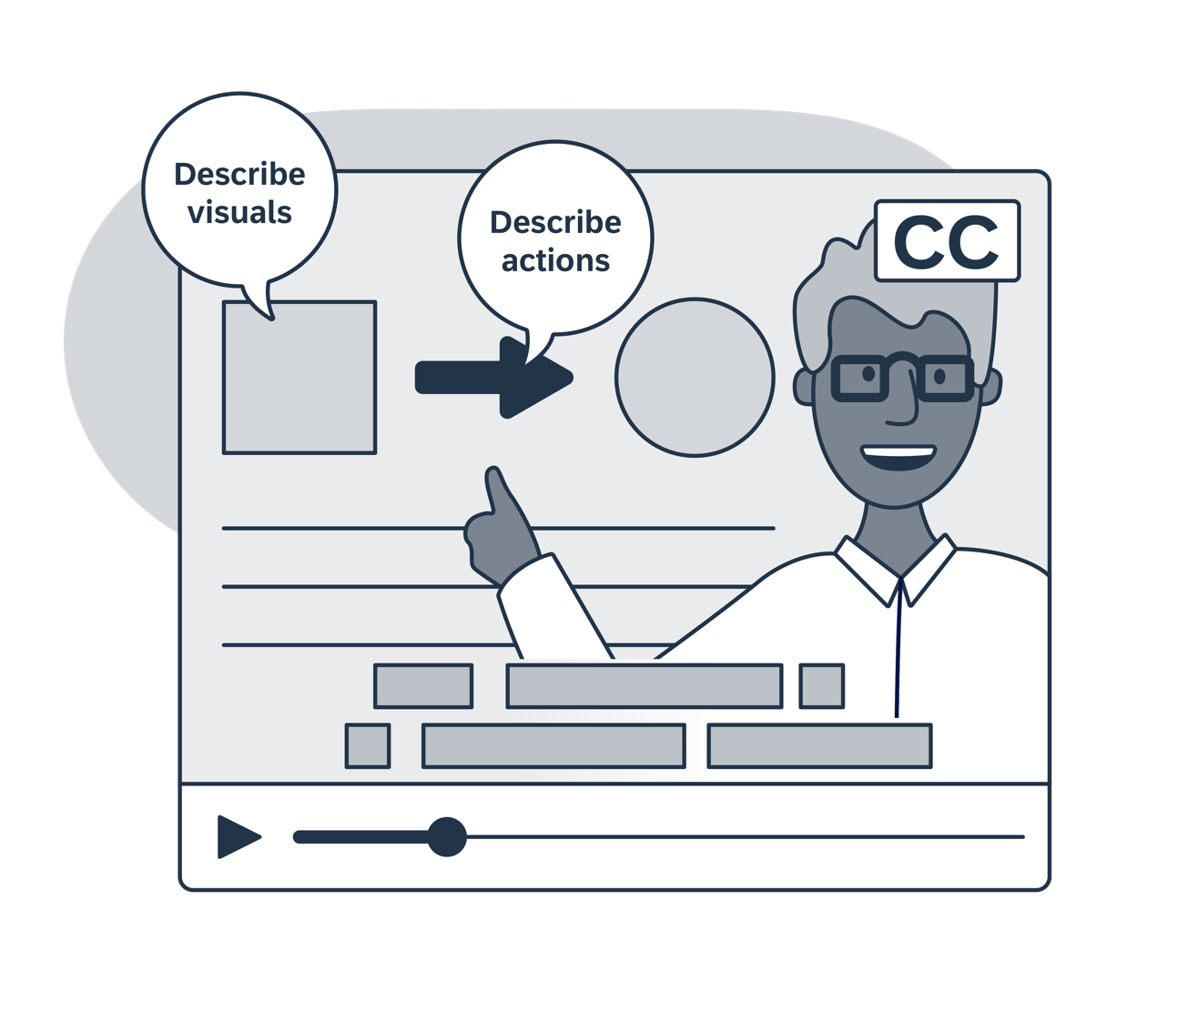
Embedded media
Using video and audio files
If you plan to show a video or to play audio during the presentation:
Ensure it contains closed captions (or subtitles) and switch them on.
Check in advance whether the subtitles need to be cleaned up.
Ensure that visual information is also verbalized, so there is no need for a specific audio description.

Slide 11
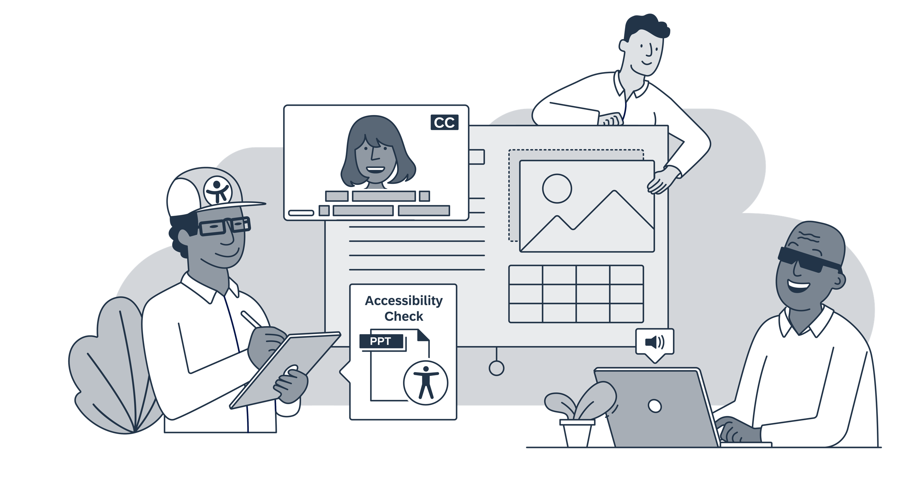
Let's make our worklife more inclusive, one meeting at a time

